Slide 1


Department of Electronics and Communication Engineering Capstone Project on AI-Powered Smart Healthcare Monitoring and Emergency Response System using Embedded System
Presented by: Chirag Sindhe-22BBTEC017 K Niranjan-22BBTEC022 K Venugopal Reddy-22BBTEC023 Vijay Kumar G-22BBTEC064
Under the Supervision Of: Dr. Amrita Singh
Assistant professor,
Department of ECE, SOET

Slide 2
Contents
Introduction
Motivation
Problem statement
Objectives
Literature Survey
Methodology
Work Timeline
Facilities (Software and Hardware)
Outcomes
Applications
Objectives achieved
References

Slide 3
Introduction
Continuous monitoring of patients is essential in hospitals to ensure timely medical care and avoid delays in treatment.
However, traditional monitoring systems are costly, wired, and restrict patient movement, making them less convenient.
To overcome this, our system uses sensors to collect vital health data such as heart rate, SpO₂, and body temperature in real time.
The collected data is processed and sent for monitoring, and in case of abnormal conditions, alert messages are generated.
This approach helps in faster medical response, improves patient safety, and supports modern smart healthcare systems.

Slide 4
Motivation
Hospitals require continuous monitoring of patients, but existing wired systems are costly and restrict movement.
Manual monitoring can delay the detection of health issues, which may increase risk during emergencies.
Many current systems depend on continuous internet connectivity, which is not always reliable.
There is a need for a low-cost, portable, and automated system to monitor vital signs in real time.
Such a system can improve patient safety and help healthcare staff respond quickly to critical conditions.

Slide 5
Problem statement
Many patients in hospitals require continuous monitoring, but current systems rely heavily on manual supervision.
Traditional monitoring systems are wired, which restricts patient movement and causes inconvenience.
These systems are expensive and difficult to maintain, especially in large hospitals.
Delays in detecting abnormal conditions can lead to slow emergency response and increased risk.
There is a need for a low-cost, wireless, and automated system that can monitor vital signs in real time and send instant alerts.

Slide 6
Objectives
Design a wireless healthcare monitoring system using ESP32 and wearable sensors
Measure vital parameters such as heart rate, SpO₂, and body temperature in real time
To process sensor data and detect abnormal conditions using threshold-based analysis
Send instant emergency alerts using GSM communication
Develop a low-cost, portable, and energy-efficient system suitable for real-world use

Slide 7

Literature Survey
Author | Overview | Findings of the Study
Sethuraman et al. (2020) | Developed MyWear, a smart wearable system that continuously monitors vital signs like heart rate and SpO₂ and sends emergency alerts through IoT. | Proved that real-time health tracking and automatic alerts can reduce emergency response time and improve patient safety.
Sharma & Kumar (2021) | Proposed an IoT-based anomaly detection model for elderly health monitoring using AI algorithms. | Demonstrated that combining AI and IoT improves the accuracy of health alerts and reduces false alarms.
Gupta & Singh (2024) | Designed an IoT-based patient monitoring system using multi-parameter sensors and GSM module. | Showed that GSM-based alert systems enhance hospital efficiency and ensure timely communication during emergencies.
Zhang et al. (2019) | Created a wearable real-time heart attack detection and warning system using continuous ECG signal analysis. | Proved that continuous monitoring and instant alerts can significantly reduce cardiac-related deaths.
Ahmad et al. (2022) | Implemented an IoT-enabled healthcare monitoring system using ESP32 and GSM for real-time data transmission. | Demonstrated a cost-effective and energy-efficient design suitable for hospitals and remote healthcare applications.

Slide 8
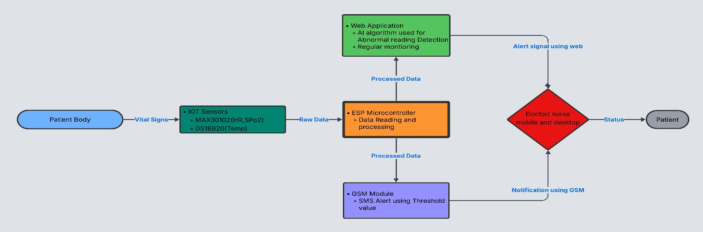
Methodology

Slide 9
Work Timeline(Completed)
Activity | Time Duration
 | Nov-26 | Dec-26 | Jan-26
Problem Definition & Requirement Analysis
Literature Survey & Reference Study
System Design & Architecture Planning
Hardware Components Selection & Assembly
Sensor Interfacing with ESP32
Real-Time Data Acquisition & Testing
Firebase Database & Web Dashboard Development

Slide 10
Activity | Time Duration
 | Feb-26 | Mar-26 | Apr-26
Backend & cloud Integration
GSM(SIM800L) Integration & Alert Logic
System Integration & Functional Testing
3D Modelling & Hardware Enclosure Design
Final testing , Validation & implementation

Slide 11
Facilities (software and hardware)
Hardware Components:
ESP32 microcontroller-main control and processing unit.
MAX30102-measures heart rate and oxygen level (SpO₂).
DS18B20-monitors body temperature.
GSM(SIM800L )-enables wireless alerts. Breadboard, jumper wires, and power supply for circuit setup. Compact casing for portable and safe hospital use.
Software Requirements:
Arduino IDE-for programming and sensor integration.
HTML,CSS and JAVASCRIPT- Used to design and build the front-end of the website.
Node.js,PHP-used as the backend to connect hardware data with web.
MongoDB- a database to store and manage patient health records securely.

Slide 12
Outcomes
A working wireless prototype for continuous monitoring of heart rate, SpO₂, and temperature
Real-time display of patient data on a monitoring dashboard
Instant SMS alerts sent to doctors or family member during abnormal conditions
Low-cost and efficient system compared to traditional monitoring equipment
Portable and battery-powered design suitable for long-term use
Supports monitoring of multiple patients with scalable design
Improves patient safety and enables faster medical response

Slide 13
Applications
Hospital Wards & ICUs: Continuous wireless monitoring of patients’ vital signs.
Post-Surgery Care: Tracks recovery and helps doctors respond quickly to any health changes.
Emergency Rooms & Ambulances: Enables real-time data transmission during patient transport.
Rural & Small Clinics: Provides affordable monitoring where advanced medical equipment is unavailable.
Smart Hospital Systems: Supports digital transformation by integrating IoT and AI into hospital networks.

Slide 14
Objectives Achieved
Module / Task | Initially Planned | Current Status (Completed / In Progress) | Next Steps (Upcoming Work)
Project Title & Objectives | Define problem and scope | Project title finalized and objectives clearly defined | No change required
Literature Survey | Review existing healthcare IoT systems | Literature survey completed and references finalized | No change required
Component Selection | Select suitable hardware modules | ESP32, heart rate sensor, temperature sensor, GSM (SIM800L) selected | No change required
Sensor Interfacing | Interface sensors with controller | Heart rate & temperature sensors successfully interfaced with ESP32 | No change required

Slide 15
Module / Task | Initially Planned | Current Status (Completed / In Progress) | Next Steps (Upcoming Work)
Data Acquisition | Read sensor data | Real-time data obtained and verified on Serial Monitor | Stable
Cloud Integration | Send data to cloud platform | MQTT used for real-time data transmission to dashboard | Working
Web Frontend | Design monitoring dashboard | Frontend website developed (HTML, CSS, JS) | Completed
Backend Development | Connect cloud to website | API integration in progress completed | Connection are done

Slide 16
Module / Task | Initially Planned | Current Status (Completed / In Progress) | Next Steps (Upcoming Work)
GSM Alert System | Emergency SMS alerts | SIM800L integrated and SMS alerts working | Reliable
AI / Data Analysis | Detect abnormal readings | AI chatbot integrated for user queries | Working
System Integration | Combine all modules | Hardware, sensors, ESP32, MQTT, and GSM integrated | Completed
Testing & Validation | Validate system performance | Module-level and system testing completed | Verified
Final Prototype | Complete working model | Prototype assembled | Ready

Slide 17
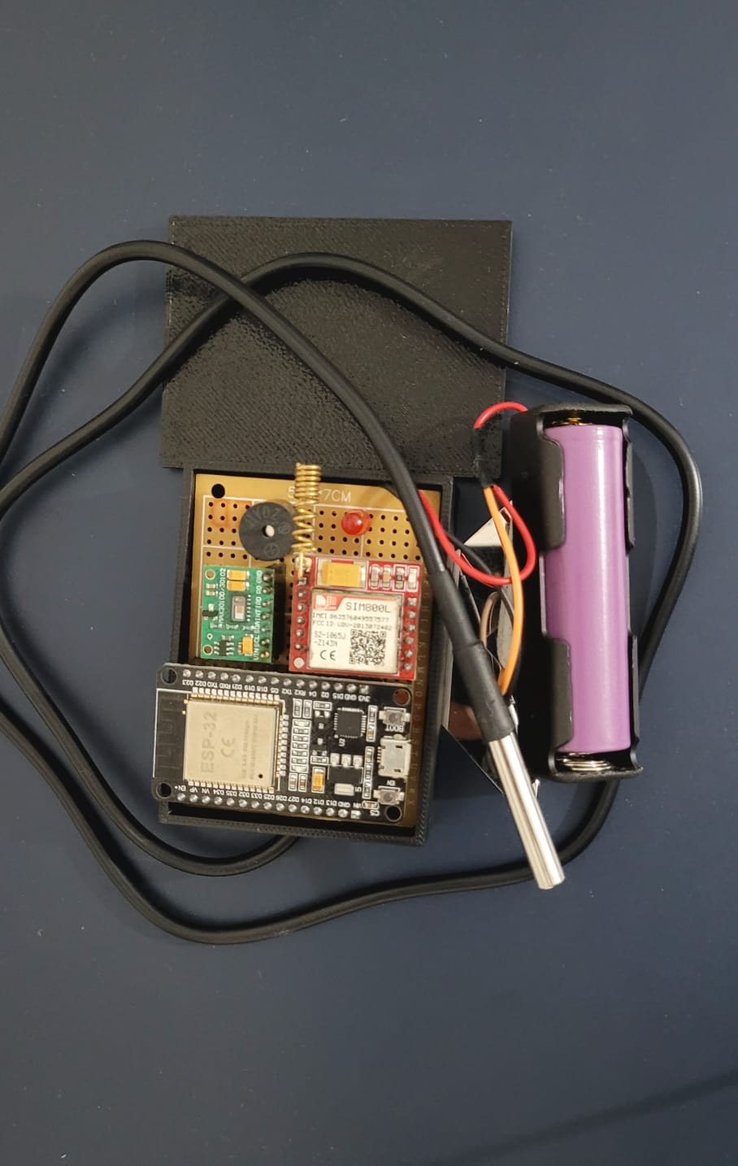
Current Hardware Prototype

Slide 18
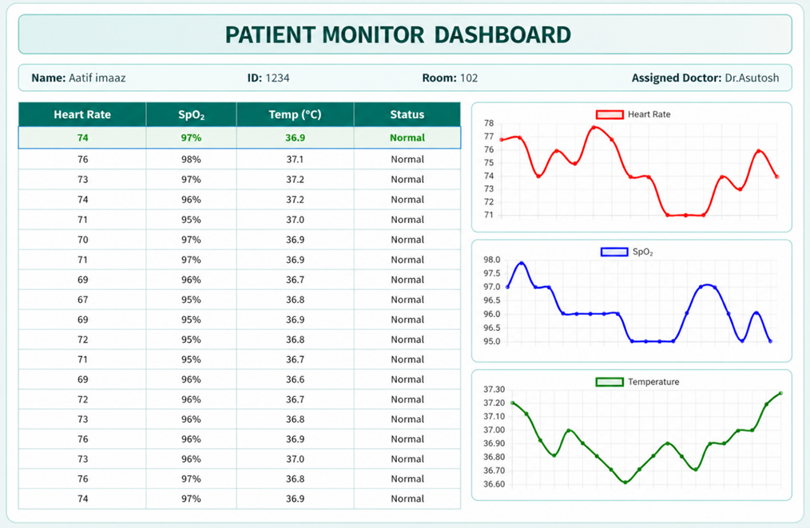
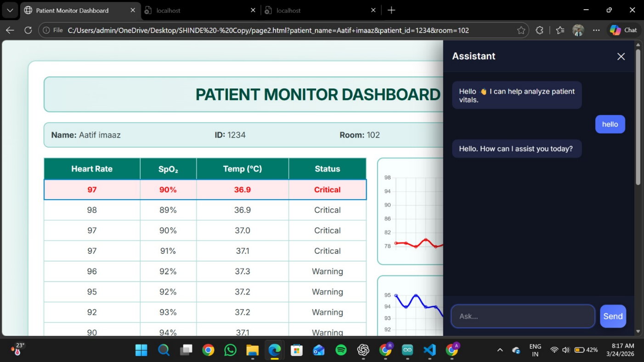
Current Hardware Prototype(Continued)

Slide 19
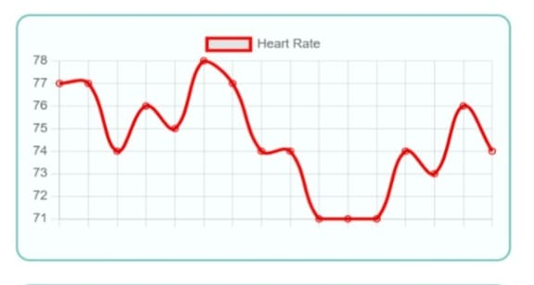
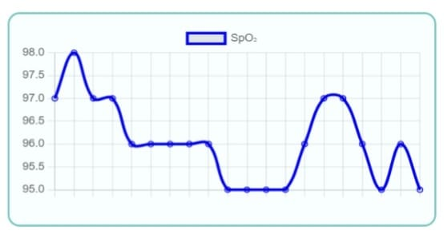
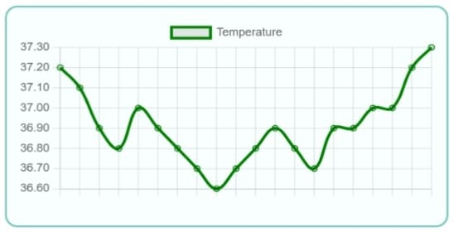
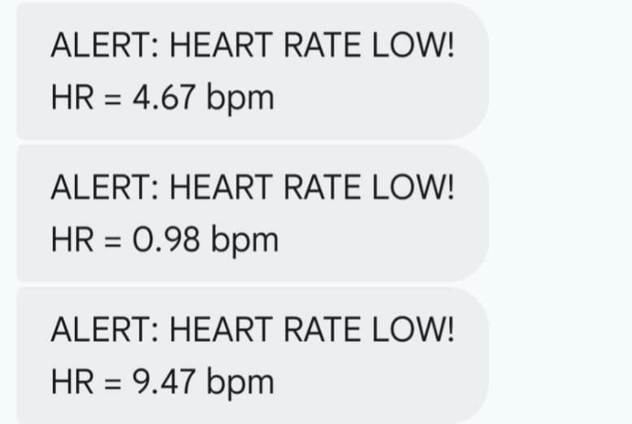
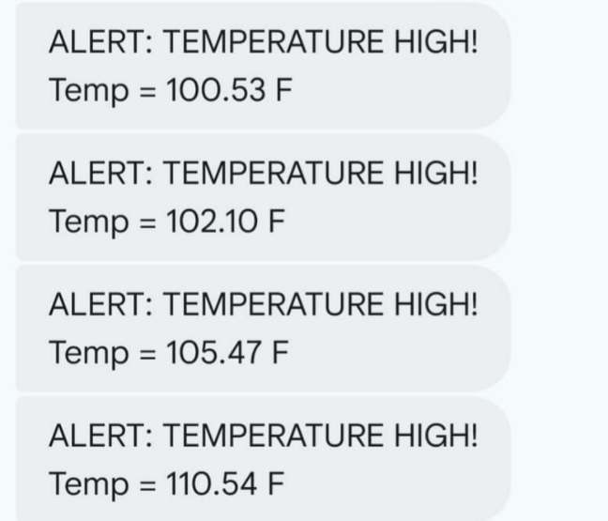
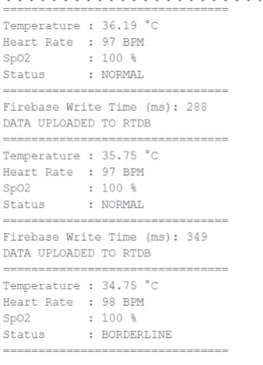
Current Hardware Prototype(Continued)

Slide 20
References
Sethuraman, S. C., Kompally, P., Mohanty, S. P., & Choppali, U. (2020). MyWear: A smart wear for continuous body vital monitoring and emergency alert. arXiv preprint arXiv:2010.08866. https://arxiv.org/abs/2010.08866
Naveena, A., Dokka, S. A., & Nadupalli, A. (2023). IoT-based patient healthcare monitoring system. International Journal for Research in Applied Science and Engineering Technology (IJRASET), 11(4). https://doi.org/10.22214/ijraset.2023.54653
Abdulmalek, S., Alkhawli, M., & Alghamdi, A. (2022). IoT-based healthcare-monitoring system: Implementation and review. International Journal of Advanced Computer Science and Applications (IJACSA), 13(5), 122–130. https://doi.org/10.14569/IJACSA.2022.0130515
Wulandari, B., & Jati, M. P. (2023). Design and implementation of real-time health vital sign monitoring device with wireless sensor-based on Arduino Mega. Elinvo (Electronics, Informatics, and Vocational Education), 6(1), 13–22. https://doi.org/10.21831/elinvo.v6i1.43799
Mnaathr, I. S., Khalifa, O. O., & Jabbar, W. A. (2023). Design remote monitoring system for patients at real-time based on Internet of Things (IoT). International Journal of Engineering and Manufacturing (IJEM), 13(5), 1–12. https://www.mecs-press.org/ijem/ijem-v13-n5/v13n5-1

Slide 21
Publication
Status of Paper
1. Chirag Sindhe¹ · Kanchepalli Niranjan ² · Venugopal Reddy³ · Vijay Kumar G⁴ · Amrita Singh^{1*} “Low-Cost Wearable Device for Real Time Health Monitoring and SMS Emergency Alerts” (communicated: “Design Automation for Embedded” Ref: Submission ID f6c593a4-c5b4-4936-b77f-973a4c54c062)

Slide 22

Participation in Seedbrains 5.0
We have actively applied and participating in Seedbrains 5.0, a national-level innovation and startup platform organized by Cambridge Institute of Technology in collaboration with Cambrian Incubation Center and CHOSS (Cambridge House of Student Startup).
Impact on Our Project
Focused on real-world problem identification and practical implementation
Enhanced scalability and future deployment potential
Encouraged alignment with industry needs and SDGs (Sustainable Development Goals)
Strengthened team collaboration, idea validation, and presentation skills
Helped in developing a startup-oriented mindset

Slide 23
Thank You

